Slide 1
Welcome to
Parent Information Night
North Dearborn Elementary School

Slide 2

Objective: The purpose of this presentation is to communicate to parents about the curriculum, services, and expectations of North Dearborn Elementary School.
Vikings

Slide 3
Indiana Department of Education Releases 2017-2018 School Accountability Grades
North Dearborn Elementary
A

Slide 4

Sunman-Dearborn Community School Corporation
Our MISSION is to provide a safe, innovative, and challenging environment designed to prepare students for their future through Stewardship, Data-Driven Decision Making, Collaboration, Shared Leadership, and Commitment.
Reflecting on our core values, the VISION of Sunman-Dearborn Community Schools is: Surpassing expectations and inspiring excellence in every student, every day.

Slide 5
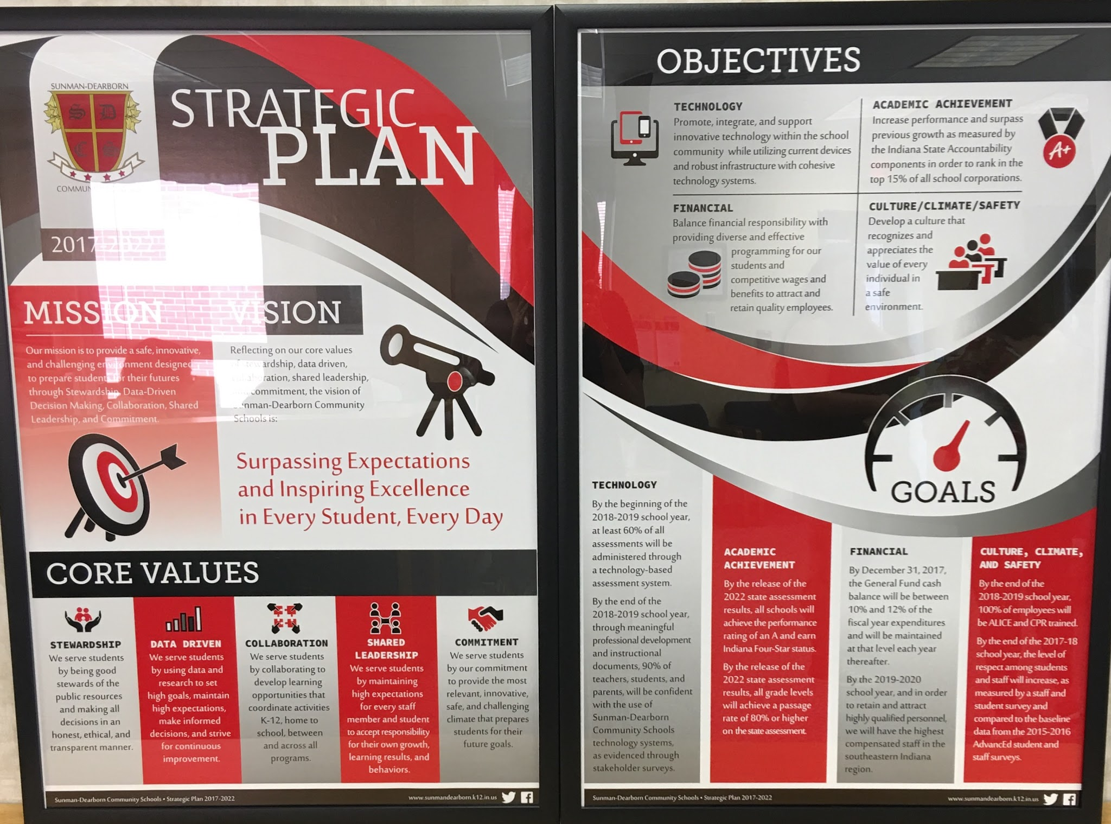
*You can find these posters hanging in all classrooms and in the common areas of NDES.

Slide 6
North Dearborn Elementary
School
North Dearborn Elementary School strives to provide a positive, nurturing climate in which our students are empowered to become lifelong learners and productive, responsible community members.
Mission Statement

Slide 7

Indiana Academic Standards
“Standards outline what students need to know, understand, and be able to do.”
2014: English/Language Arts and Mathematics
2016: Science
In 2017: Health, PE and Visual Arts
2018: Music
These new standards are the result of a process designed to identify, evaluate, synthesize, and create high-quality, rigorous standards for Indiana students. They have been validated as college and career ready so students who successfully master these objectives by the time they graduate from high school will be ready to go directly into the workplace or a postsecondary educational opportunity without the need of remediation. Academic standards are benchmark measures that define what students should know and be able to do at specified grade levels beginning in kindergarten and progressing through grade twelve. The standards are promulgated as state regulations.
To check out the standards for each subject area and grade level, refer to the Indiana Department of Education website. http://www.doe.in.gov/standards

Slide 8
Vertically Aligned Standards
This is the same number sense math standard K-5th grade.
K.NS.1: Count to at least 100 by ones and tens and count on by one from any number
1.NS.1: Count to at least 120 by ones, fives, and tens from any given number. In this range, read and write numerals and represent a number of objects with a written numeral.
2.NS.1: Count by ones, twos, fives, tens, and hundreds up to at least 1,000 from any given number.
3.NS.1: Read and write whole numbers up to 10,000. Use words, models, standard form and expanded form to represent and show equivalent forms of whole numbers up to 10,000.
4.NS.1: Read and write whole numbers up to 1,000,000. Use words, models, standard form and expanded form to represent and show equivalent forms of whole numbers up to 1,000,000.
5.NS.3 and 4: Recognize the relationship that in a multi-digit number, a digit in one place represents 10 times as much as it represents in the place to its right, and inversely, a digit in one place represents 1/10 of what it represents in the place to its left. Explain patterns in the number of zeros of the product when multiplying a number by powers of 10, and explain patterns in the placement of the decimal point when a decimal is multiplied or divided by a power of 10. Use whole-number exponents to denote powers of 10.

Slide 9
District-wide Initiatives
Pacing Guides and Common Assessments
Guide instruction
Promote collaboration
Continuous Work in Progress
Pacing Guides prepare for Common Assessment
Common Assessments measure instructional effectiveness and provides data to make improvements

Slide 10
Technology Integration
EC and S-DMS are 1:1 Chromebooks
Elementaries are next to be considered
NDES has five Chromebook carts for sign out
Wireless projectors
Digital Citizenship Curriculum K-5
Teachers - Monthly Tech PD
Summer training opportunities
New Computer Science standards just released

Slide 11
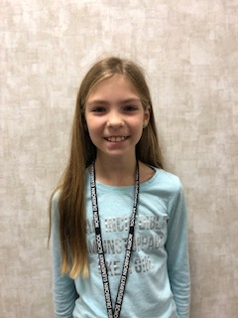
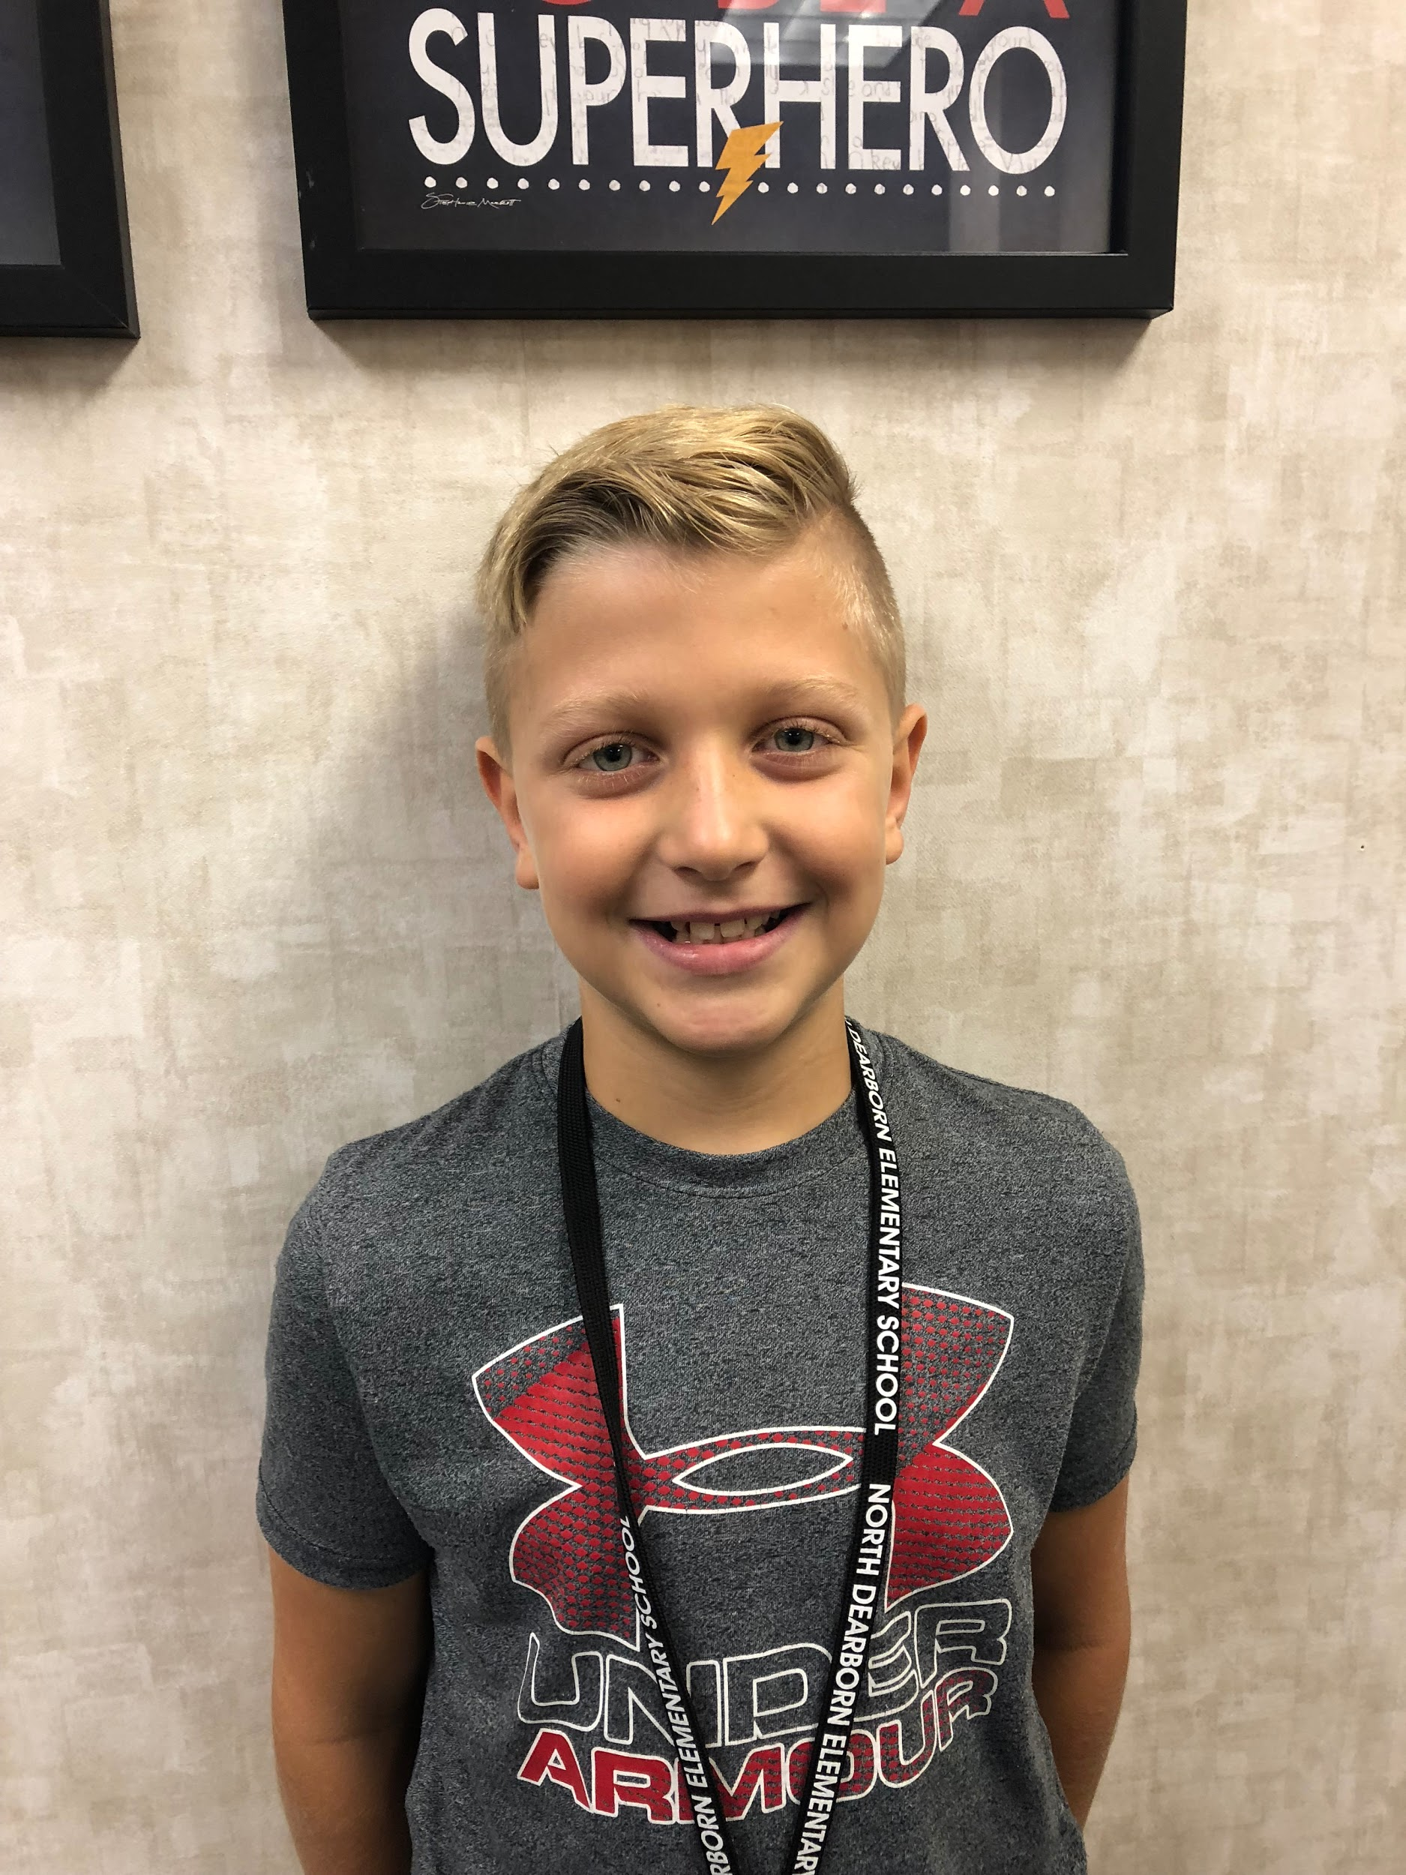
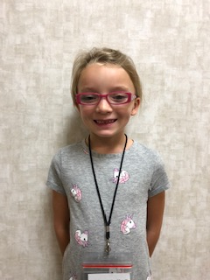
School-Wide Initiatives
School Motto:
To be a Viking I must:
be ready to learn,
be respectful,
be responsible and safe!
Viking Code:
Expectations for behavior
All common areas of school
Classroom incentives
Viking of the Month
View our handbook on our webpage.

Slide 12
Professional Learning Communities
Our school has several staff committees to improve the culture, learning environment, and instruction at NDES.
Leadership Team
Viking Code (School-wide Behavior)
Professional Development
Environmental
Safety
RtI
Social

Slide 13



Communication
NDES school webpage
Teacher webpage/Google Site Agendas
Monthly Newsletters Email
Twitter @NorthDearborn Phone call
Facebook
School Messenger

Slide 14
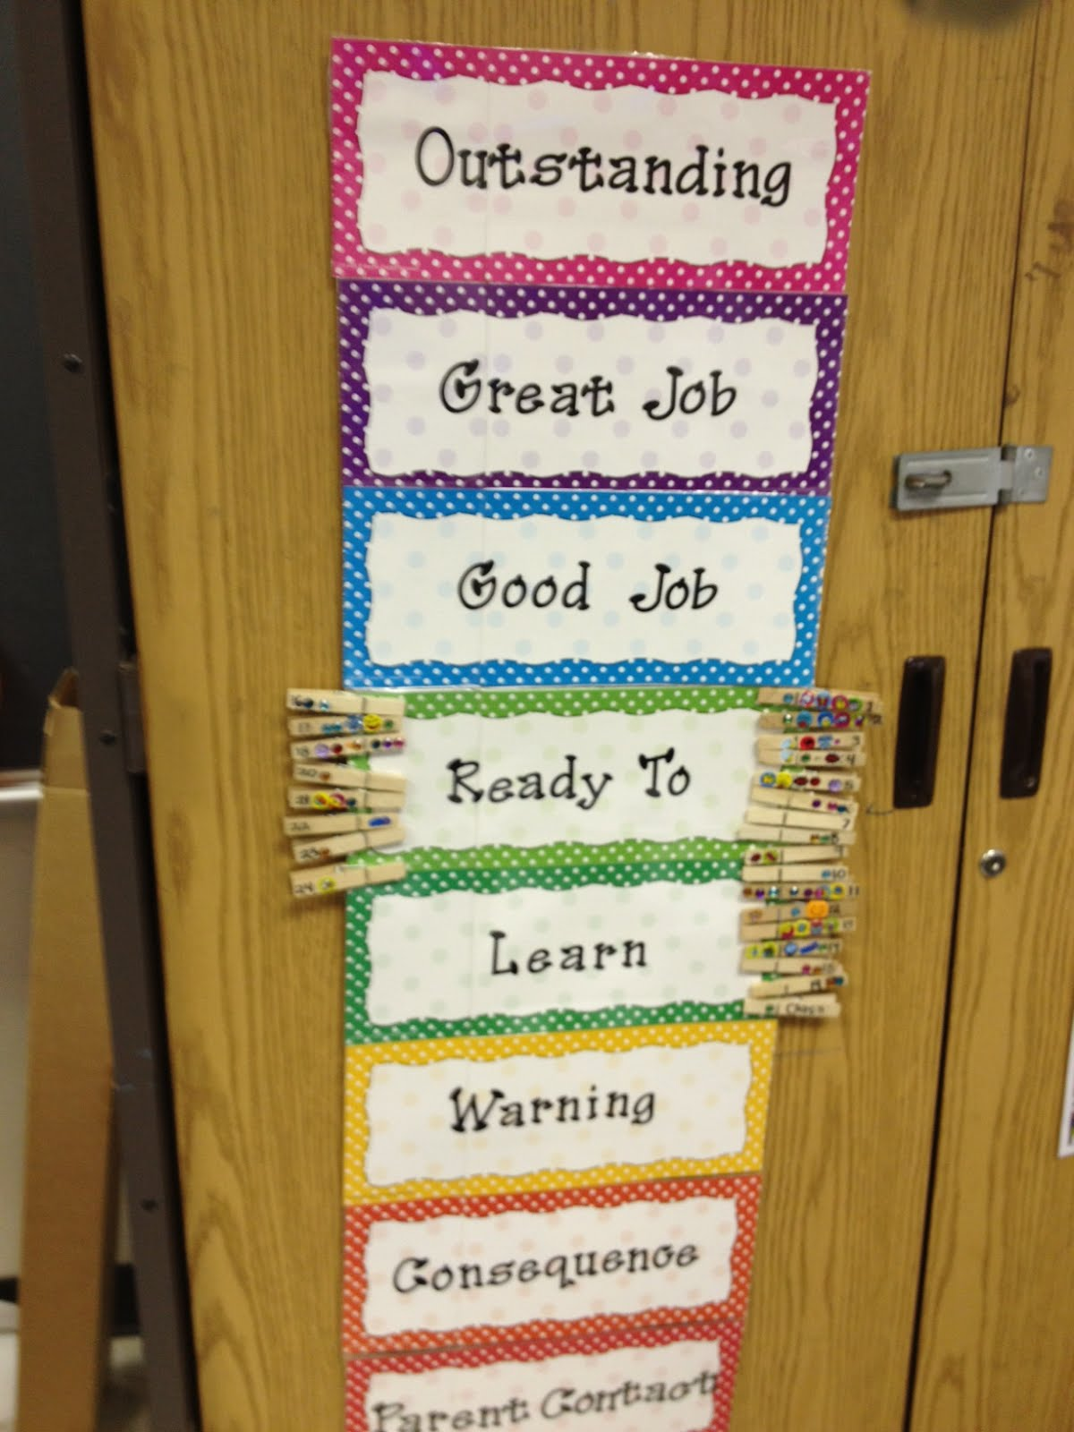
Classroom Discipline
The Viking Code is the school-wide discipline system for all common areas such as the cafeteria, restrooms, playground, computer labs, science labs, and hallways. Students earn Viking Vouchers as a class and individually for positive behavior.
To maintain teacher autonomy, individual teachers have a discipline system within their own classroom. All classrooms have a discipline system, including clear expectations, procedures, and consequences. Many classrooms use the clip chart system. Fifth grade uses a behavior chart.

Slide 15
North Dearborn Elementary
School Staff
Administrators: Dr. Andrew Jackson, Superintendent Ms. Cindy Morton, Director of Student Services Jeff Bond, Principal Barb Katenkamp, Assistant Principal | Cafeteria Staff: Cheryl Erhart, Food Service Director Head Cook: Darlene Werner Custodians: Mike Ireland, Blaine Werner, Gina Dirkhising, Jack Hotopp
Office Staff: Holly Drees, Beth Powell School Nurse: Karen Sue Harrill and Megan Ripperger Librarian: Nancy Lyle | Instructional Aides: Meghan Andres, Jackie Batta, Christine Bosse, Heather Bowling, Diana Cheek, Jodi Christman, Robynn Collins, Mendy Cook, Hannah Cook, Katie Eckstein, Shannon Eley, Marcia Hornberger, Colleen Knigga, Leasha Kushman, Miranda Lobenstein
Counselors: Mandy Stenger Nikki Christen | Jennifer Parr, Laurie Patton, Terri Price, Tricia Puterbaugh, Marci Reynolds, Jamie Schillinger, Beth Smith, Judy Welte, Michelle Wyatt Teachers: see following slides

Slide 16


Special Area: PE
All students in grades K-5 attend PE class one time per week.
Teacher: Bill Theising
Goal: To provide students with the knowledge and skills necessary for the development of a healthy and active lifestyle.
Process:
  Skill development for K-2 (throwing, catching, jump rope, sportsmanship, etc.)
  Continued focus on locomotor (skip, gallop, walk, etc.), non-locomotor (bend, straighten, twist, etc. )skills throughout grade levels
  Integrating new activities (roller skating, dodgbee, and gaga) and life long activities (bowling, basketball, volleyball, etc.) to promote interest in being active
  Heavy focus on being active and the benefits of a healthy lifestyle
Students are expected to bring proper shoes to each class.
Notes:
Billy

Slide 17


Special Area: Music
All students in grades K-5 attend music class one time per week.
Teacher: Julie Simpson
Concepts | Performances | Ensembles
Singing-songs from different genres, countries, and time periods Playing a variety of instruments (including recorders) Expressing creativity through improvisation and composing Learning to read music, both rhythmically and melodically Listening to and describing a variety of musical selections Relating music to other subjects, such as math, language, science, history, and art Performing as individuals, but more importantly learning how to work together and perform as an ensemble Studying composers from different time periods and learning about music from various parts of the world | Students in grades 1-5 have the opportunity to participate in a concert each school year. This is a wonderful opportunity for students to experience the preparation and practice that goes into a performance. It also provides students with the opportunity to perform with their peers on a stage, for an audience. | Chorus Percussion audition and perform at concerts and community venues
Notes:
Julie W

Slide 18





Special Area: Art
All students in grades K-5 attend art class one time per week.
Teacher: Julie McAdams
Students are expected to bring an art box with them to class each week.
Grading-Grades are based on an average from 50% behavior, safety, and preparedness and 50% from projects they complete in art. All areas will be assessed using a rubric.
Newsletter(s)-posted monthly on classroom website with reminders and information about what is going on in the art room.
Twitter-If you have a Twitter account, Mrs.McAdams updates her classroom page daily. You can follow her @NDESARTROOM to see student work and much more.
Website-You can link to our art room website through the school website. Be sure to bookmark it so see more information about our class.
Our 5th annual ART SHOW is an opportunity to show off our students’ hard work and recognize them as artists. Dates: April 25th for K, 1, 2 and May 2nd for grades 3, 4, 5.

Slide 19

Special Area: Library
All students in grades K-5 attend library class one time per week.
Librarian: Nancy Lyle
Students will check out a fiction and a nonfiction book during their library time.
Mrs. Lyle will provide lessons on literary genres, nonfiction elements, parts of a book, book reviews, dictionary skills, and reader’s theater.
The library is open every morning from 7:45-8:05 for book exchange.

Slide 20

Special Area: Computer
All students in grades K-5 attend computer class one time per week.
Teacher: Grade Level Assistants
Students will learn basic keyboarding skills, how to conduct research, create word processing and digital presentations, take computer-based assessments, and more. All students will participate in a Digital Citizenship program, grades K-5.

Slide 21

Kindergarten
Teachers:
Beth Sizemore
Karen Stange
Dyna Stickford
Bonnie Lobenstein
Angie Prifogle
Goals:
To master all kindergarten skills in math, reading, writing, science, and social studies.
Develop positive social skills
Becoming lifelong learners

Slide 22
Kindergarten
Resources:
Journeys Reading
My Math Textbook
Pearson science
Digital Citizenship
Scholastic News
Zaner Bloser Handwriting
Educational websites
Reading Eggs
Instructional Strategies:
Daily Work Stations
Small Group Work
RtI
LIPS techniques
Orton-Gillingham techniques
Songs and music
Large/fine motor activities

Slide 23
Kindergarten
Assessments:
Report card sent home each quarter
Midterms sent home as needed
Quarterly Reading & Math common assessments
Star Early Literacy
Observation
DIBELS Progress monitoring
Homework Expectations:
Read DAILY (read to, read with, read independently)
Weekly Take-Home readers
Play games as a family
Review Sight Words daily
Weekly math and reading/writing homework to review previously learned skills.
Homework should take no more than 10-15 minutes per night.

Slide 24
KindergartenReport card and grading:
All kindergarten teachers in the district use a Standards-Based Grading system. Throughout each quarter we will collect data of each student’s achievement through student work, performance tasks, observations, and end of quarter assessments. Achievement is identified through a 4, 3, 2, and 1 number system on quarterly report cards.
4 Exceeding - Student is working above grade-level expectations.
3 Established - Student is consistently mastering current grade-level expectations.
2 Emerging - Student is making progress towards mastery of current grade-level expectations.
1 Deficit - Student has yet to meet current grade-level expectations and is not making satisfactory progress towards meeting them.

Slide 25
Kindergarten
Guest Speakers/ Special projects:
Fire Department
Karen Blasdel for Dental month
Disability awareness month
LPLD Outreach Reading Program
100th day celebration
Read Across America week
Thanksgiving break”feast”
Field Trips:
*Field Trips could change
Fall
Bright Community Field Trip
Wendel Farms
Spring
Cincinnati Children’s Museum

Slide 26

1st Grade
Teachers:
Melanie Messmore
Lauren Franks
Olivia McAdams
Melissa Dennis
Glenda Baker
Goals:
Students will be able to decode, read, and comprehend grade appropriate material across the curriculum.
Students will become fluent with their basic addition and subtraction facts.
Students will learn how to be a good citizen in their school and their community.
Students will engage in science through reading, inquiry, and technology.

Slide 27
1st Grade
Resources:
Journeys Reading
My Math Textbook
My World Social Studies
Scholastic News
Interactive Science
Instructional Strategies:
Pre-test to dtermine prior knowledge
Differentiate by providing activities that challenge all students
Provide purpose for learning by making connections to student’s experiences and the world
Engage students in meaningful activities
Provide students with the opportunity to share what they have learned
Post-test to determine mastery of skills and plan for interventions and differentiation

Slide 28

1st Grade
Homework:
Nightly Reading Assignments
(Take-Home books, Reading book)
Sight Word and Spelling Practice
Math Homework and +/- flashcards
Assessments:
Edmentum
DIBELS
Grades:
First grade uses a Standards-Based Grading system. Achievement data is collected through daily work, performance tasks, observations, weekly tests, and end of quarter assessments. Achievement is identified through a 4, 3, 2, and 1 number system.
4 Exceeding - Student is working above grade-level expectations.
3 Established - Student is consistently mastering current grade-level expectations.
2 Emerging - Student is making progress towards mastery of current grade-level expectations.
1 Deficit - Student has yet to meet current grade-level expectations and is not mak9ing satisfactory progress towards meeting them.
Notes:
Glenda

Slide 29

1st Grade
Guest Speakers/
Special projects:
Vermicomposting Program through Dearborn County Recycling Center
Karen Cody, a naturalist, will present information to the students about animal life cycles.
Field Trips:
*Field Trips could change
Blooms and Berries to view farm animals and discuss pumpkin life cycle.
Children’s Theater to give students an experience in the arts.
Cincinnati Zoo--We will visit the zoo in May as a culminating activity to our unit on animal life cycles.

Slide 30
2nd Grade
Teachers:
Lee Anne Dole
Jolynn Eckstein
Kendra May
Hilary Stonefield
Rita Weaver
Goals:
Student will Increase number sense, become more fluent with their math facts and understand how numbers relate to each other. (EXAMPLE: fact families 3+7=10, 7+3=10, 10-3=7, 10-7=3)
Students will have a basic understanding of our community and the services provided.
Students will be able to read and comprehend a grade level text fluently and apply this to other subject areas.
Notes:
Barb

Slide 31
2nd Grade
Resources:
Edmentum: Exact Path and Study Island to target individual needs
Junior Great Books
Drops in a Bucket spiral review
Instructional Strategies:
Spiral review strategies in math and language arts such as Drops in a Bucket
Calendar Math
Math problem solving strategies such as CML and Problem Solver
Notes:
Barb

Slide 32
2nd Grade
Assessments:
Common grade level assessments
DIBELS
Edmentum
Homework Expectations:
Homework is practice - parental help encouraged
Nightly reading, vocabulary, math facts, and/or spelling practice expected
20-30 minutes each night is a reasonable amount of time for second grade.
Notes:
Kendra

Slide 33
2nd Grade
Guest Speakers/
Special projects:
Community Service Project
Cool Critters Presentation
Gingerbread Houses
Field Trips:
*Field Trips could change
Newport Aquarium -focuses on hands-on experiences, viewing animals in water ecosystems and aquatic life cycles
Reds Stadium and Hall of Fame - focuses on community history
Notes:
Jolynn

Slide 34
3rd Grade
Teachers:
Cindy Hornbach
Shanon Klei
Jamie Oelker
Melissa Scudder
Brenda Stewart
Goals:
Increase students’ basic math fact automaticity
Improve the quality of students’ constructed response answers
Increase students’ self- sustained reading stamina
Apply problem solving strategies in math
Notes:
Melissa

Slide 35
3rd Grade
Resources:
Digital Citizenship Curriculum
Novels
Journeys Reading Series / Leveled Readers
McGraw Hill Math Series
Pearson My World Social Studies
Smart Word Readers for Social Studies and Science
Instructional Strategies:
Hands On Activities
RACE method for constructed response questions
Digital Learning with ConnectEd Math Resources
Small grouping for reading and math

Slide 36
3rd Grade
Assessments:
IREAD3
ILEARN
Quarterly assessments in Reading, Writing, Grammar, Math, Social Studies
Edmentum Test (Fall, Winter, Spring)
Easy CBM Comprehension, Word Fluency, Story Fluency
Homework Expectations:
The purpose of homework is to reinforce a previously presented skill. Please make sure to assist your child and ensure that he/she is doing the homework correctly.
Students should be reading for 15 - 20 minutes each night.
Practice basic math facts.

Slide 37
3rd Grade
Guest Speakers/
Special projects:
Dearborn County Research Project and Report
Liz Beiersdorfer / Simple Machines
Native American Activity Day
Dr. Seuss Celebration Day
Field Trips:
*Field Trips could change
Dearborn County-Dearborn County Courthouse and a visit with Judge Humphrey, Dearborn County Historical Society, Hillforest Mansion: This field trip connects our students with the community in which they live. They get to experience how our area has grown and changed over time.
AG Day-Presented by Dearborn County- Purdue Extension: This field trip exposes students to different agricultural and livestock resources from our area.

Slide 38
4th Grade
Teachers:
Melanie Beetz
Malorie Dickhaus
Pat Harper
Sharon Moder
Brooke Packer
Goals:
Students will cite evidence to support answers.
Students shift from learning to read, to reading to learn, especially in areas of Science and Social Studies.
Students will become more independent and responsible learners.
Students will be able to explain math computation and reasoning.
Notes:
Sharon

Slide 39
4th Grade
Resources:
Edmentum: Exact Path and Study Island
Journey’s Reading Textbook
My Math Textbook
Junior Great Books
Science and Social Studies Textbooks
Novels
Scholastic News
Instructional Strategies:
RACE Response Format
Differentiated Instruction for Reading and Math using Flexible Grouping
Kinesthetic Learning strategies
Self Monitoring and Performance feedback through Data Folders
RtI (Response to Intervention)
UPSC charts for Math word problems

Slide 40
4th Grade
Guest Speakers/
Special Projects:
Kevin Stonerock (Civil War soldier)
Danny Russell (James Whitcomb Riley)
Rationing Activity (WWII)
Economics Fair project in 3rd quarter
Hoosier Biography report and project in 4th quarter
Field Trips:
*Field Trips could change
Governor Bebb Metro Park -
4.3.4 Map physical regions of IN and identify major natural resources and crop regions.
4.3.9 Explain the importance of major transportation routes in the exploration, settlement and growth of Indiana.
Krohn Conservatory & Cincinnati Observatory -
4.ESS.1 Invesitgate how the appears to move through the sky, how it impacts the Earth, rising and setting times, and solar and lunar eclipses.
4.LS.1 Observe and analyze how offspring are like their parents. Describe how different physical characteristics help them to survive.

Slide 41
4th Grade
Assessments:
Quarterly Assessments over curriculum taught
ILEARN - Language Arts, Math, and Science
Edmentum Testing: Fall, Winter, and Spring
Homework Expectations:
While we are working on building independence, students may still require support from parents.
Reading AR 20 min.per night
Students should only have a maximum 40 minutes of homework in 4th grade.

Slide 42
5th Grade
Teachers:
Nancy Lillie
Jenny Shattuck
Cathy Sopcisak
Kelly Ravenna
Lori Robinson
Goals:
Foster organizational skills and agenda usage to be independent learners
Practice and act by the Viking Code to be role models for younger students.
To empower them with learning tools to become lifelong learners.
Mastery of 5th grade College and Career Readiness standards.

Slide 43
5th Grade
Resources:
Edmentum for individualized reteaching and practice
Smekens Comprehension Strategies
Accelerated Reader
Online sites with Math, Reading, Blue Vocab, Social Studies, and Science textbook.
Instructional Strategies:
Frameworks to create a constructed response:
  RACE-(restate, answer, cite, explain)
  Yes Ma’am (Me, Author, Author, Me)
Phonetics to improve spelling
Use of dictionary and thesaurus to enhance vocabulary:
  definitions, parts of speech, synonyms, antonyms, affixes.
Differentiation to help meet needs of individual students.
Mnemonic devices to aid memorization

Slide 44
5th Grade
Assessments:
Reading comprehension tests
Pre-tests in math to determine pacing of chapter
Required ILEARN testing
Edmentum reading and math to determine present levels, growth and grouping
Quarterly assessments for progress monitoring.
Homework Expectations
By using the agenda, students become responsible: bringing home what is needed and completing it. This helps them become good communicators between home and school.
Stay organized: putting work in the correct place to bring home and to return to school.
Complete any work not finished at school that is due.
study for tests
Read 20 minutes each night for AR

Slide 45
5th Grade
Guest Speakers/Special projects:
Molly Resendes: Edible Landfill with Dearborn County Recycling.
Operation Christmas Child
Kat Lillie: Virtual Field trip to Sea Turtle Inc. at S. Padre Island, TX
Get Real About Tobacco program
Citizenship Projects
JPL NASA Video Conference
Field Trips:
*Field Trips could change
Dinsmore Homestead-Focuses on primary sources to research the past
Skating Rink-includes content area connections to physical activity through PE class
Redwolf Sanctuary-Focuses on science environments and animals and our connection to them

Slide 46
Report Cards
Kindergarten & First Grade | Standard-based (1, 2, 3, 4)
Special areas (Art, Music, PE) use O, S, and N grade scale.
O - outstanding
S - satisfactory
N - needs improvement
A = 90-100
B = 80-89
C = 70-79
D = 60-69
F = 59-0
O, S, N A-F
2nd | Citizenship, Science, Writing Social Studies | Reading, English, Math
3rd | Citizenship, Social Studies | Reading, English, Math, Science, Writing
4th & 5th | Citizenship | Reading, English, Math, Science, Social Studies, Writing

Slide 47
Response to Intervention (RTI)
Each grade level has 30 minutes built into their daily schedule to meet the individual needs of students. This may done in small groups or individually.
Tier 1: Mastering grade level standards or beyond.
Tier 2: Needing additional support to meet grade level standards.
Tier 3: Needing intense intervention to succeed at current grade level.
Students not progressing with Tier 3 support may be referred for special education testing.
Students who are excelling at current grade level may receive enrichment and acceleration of standards.

Slide 48
General Education Intervention (GEI)
Team of teachers, counselors, and parents who meet to discuss ways to help a struggling child succeed using research-based strategies
Progress monitoring data is kept and reviewed
Students not improving with additional resources and strategies may be referred for special education testing.

Slide 49
Special Education
Our school district is part of a special education cooperative, ROD, shared by several school districts in Ripley, Ohio, and Dearborn Counties. ROD does special education evaluations, and supports our school with services such as occupational/physical therapy, counseling, and vision and hearing assistance for students who qualify.
NDES Special Education Teachers:
Elyse Gorman, Amy Jones, Ali Gandenberger, Danielle Metz, Tamela Monhollen, Amanda Gulley, Bobbi Bauman

Slide 50
Available Services
* For students who qualify based on state eligibility
Speech Therapy-Tamela Monhollen
(articulation,voice, fluency and language remediation)
District Pre-School-Bobbi Bauman (developmentally delayed 3-4 year old students)
District Moderate Classroom-Amanda Gulley
(moderately and severely handicapped students)

Slide 51
High Ability Services
School Ability Tests administered to all students in grades K, 3, and 5.
Referrals for testing taken in grades 1, 2, and 4.
Students will be considered “on watch” until 3rd grade testing.
All parents will receive OLSAT testing results after 3rd (spring) and 5th grade (fall) testing. Identification letters will be sent home to students meeting required criteria after Spring HA identification meeting.
School Cluster Group Model (SCGM) is used to service high ability students in the general education classroom and provide differentiated services for all.
For more information, see High Ability Services Handbook on our website or contact Barb Katenkamp, HA Services Coordinator.
Notes:
Kelly

Slide 52
School Counseling
Counselors: Mandy Stenger and Nikki Christen
Special Education intervention and referral process
State Testing Coordination
Family and student resource assistance
Small group counseling
  Social/emotional, grief, friendship skills, etc.
Drug Free Awareness
School success strategies
Notes:
Kevin and Mandy

Slide 53

School Nurses
Karen Sue Harrill and Megan Ripperger
Provide first aid for accidents occuring at school
Can administer Tylenol, with consent, for headaches
Daily prescribed medication administration. Medicine must be sent in the original container with a doctor’s note
Vision screenings: grades K, 1st, 3rd, 5th, and upon teacher referral
Hearing screenings: grades K, 1st, 4th, and upon teacher referral
Notes:
Kelly-medicine forms are on top of filing cabinet in Nurse Joanie’s office if anyone asks for one

Slide 54
Ways to get involved…
PTO (meets second Monday in the cafeteria 3:30 or 6:30. Check FB)
Classroom Volunteer
Field Trip Chaperone
Party Volunteer
Lunch Guest
School Board Meetings

Slide 55
Special School-Wide Functions
*This is a list of things we have done in the past. Functions will vary from year to year.
Choral Concerts
Veteran’s Day
Art Shows
Parent/Grandparent Information Sessions
CMHC presentations - Think Smart..., Kids on the Block
Career Week
Red Ribbon Week
Movie Nights (PTO)
Spring Carnival (PTO)
Father/daughter, Mother/son events (PTO)

Slide 56
Questions????
Please feel free to contact any staff member with questions about North Dearborn Elementary School. Contact information can be found on the school’s website.
http://ndes.sunmandearborn.k12.in.us/

